Slide 1
KIET Group of Institutions, Ghaziabad
Deep TrafficFlow: A Deep Learning Approach for Real-Time Traffic Monitoring and Congestion Reduction
Group ID: PCSE25-59
Team Leader: Vikas Kumar Semester : 8 Department: CSE
Group Member: Shreyansh Tiwari Semester : 8 Department: CSE
Name of Guide: Mr. Rahul Kumar Sharma
Date of Presentation: 27-05-2025
1
Date of presentation: 17-05-2023

Slide 2
KIET Group of Institutions, Ghaziabad
Mapping of Our Project with Sustainable Development Goals (SDGs)
01 SDG 3 – Good Health and Well-Being
02 SDG 9 – Industry, Innovation and Infrastructure
03 SDG 11 – Sustainable Cities and Communities
04 SDG 13 – Reduces vehicle idle time and emissions through optimized traffic flow

Slide 3
KIET Group of Institutions, Ghaziabad
Course Outcome
CO no. | Course Outcome
CO1 | Apply machine learning and deep learning algorithms for real-time traffic detection and congestion prediction.
CO2 | Integrate surveillance systems and video analytics for automated vehicle tracking and monitoring.
CO3 | Design and develop a smart traffic management system using computer vision and predictive modeling techniques.
CO4 | Evaluate the accuracy and efficiency of the system using standard performance metrics (e.g., precision, recall, F1-score).
Program Outcome
PO no. | Program Outcome
PO1 | Engineering Knowledge: Apply computer vision, deep learning, and AI concepts to solve real-world traffic challenges.
PO2 | Problem Analysis: Identify, analyze, and address issues in vehicle detection, traffic congestion, and flow management.
PO3 | Design/Development of Solutions: Design and implement intelligent, scalable systems for real-time traffic monitoring.

Slide 4
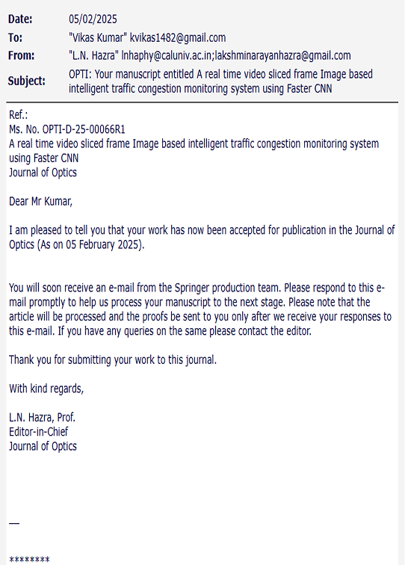
Project Outcome
KIET Group of Institutions, Ghaziabad

Slide 5
KIET Group of Institutions, Ghaziabad
Project Objectives
Real-Time Traffic Monitoring: Utilize computer vision and deep learning (Fast R-CNN) to continuously monitor traffic flow from video feeds for accurate vehicle detection and classification.
Intelligent Congestion Prediction: Implement machine learning models (e.g., Random Forest) to analyze traffic density and patterns for early prediction of congestion, enabling proactive management.
Anomaly and Incident Detection: Track vehicle trajectories using Kalman filters to identify unusual movement patterns (e.g., sudden stops, illegal lane changes) that may indicate accidents or disruptions.
Scalable and Automated Traffic Control: Design a modular, real-time system capable of integrating with smart city infrastructure (e.g., adaptive traffic signals, emergency dispatch) to improve urban mobility and reduce manual oversight.

Slide 6
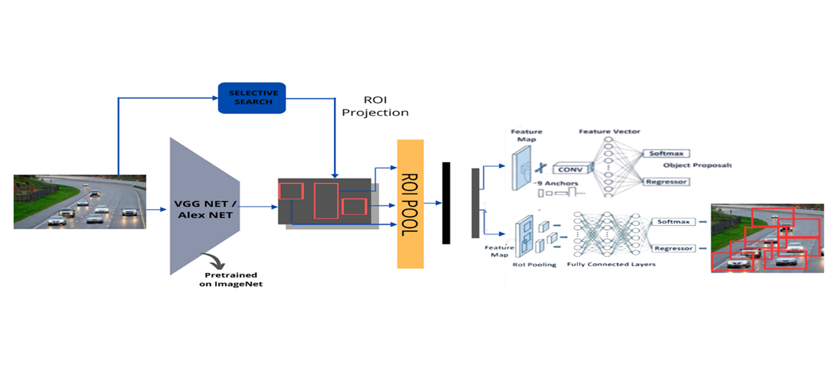
FlowChart OF Model
KIET Group of Institutions, Ghaziabad

Slide 7
KIET Group of Institutions, Ghaziabad
Models Used:
Fast Convolutional Neural Networks (CNN):
Used for real-time vehicle detection and classification from traffic surveillance footage.
Implemented using Fast R-CNN, which provides accurate bounding boxes and class labels for various vehicle types (car, truck, bike, etc.).
Random Forest:
Applied for traffic congestion prediction based on historical data.
Kalman Filter:
Used for vehicle tracking and path prediction across multiple frame.
Dataset:
Image Dataset:
Real-world traffic surveillance footage of intersections and highways.
Sourced from Kaggle and MIT Dataset
Sensor Dataset:
20000+ time stamp data point
Features – Vehicles count , Timing

Slide 8
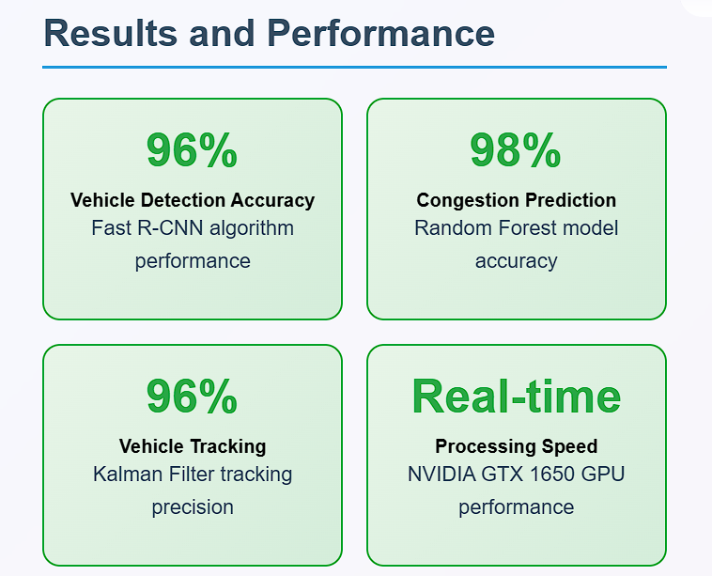
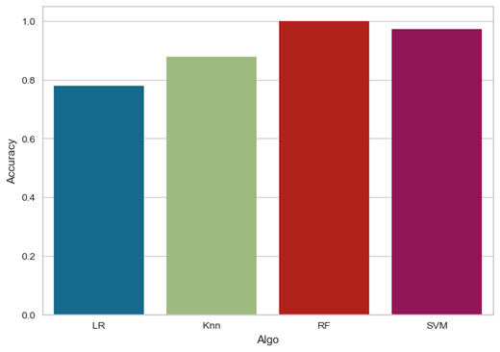
KIET Group of Institutions, Ghaziabad

Slide 9
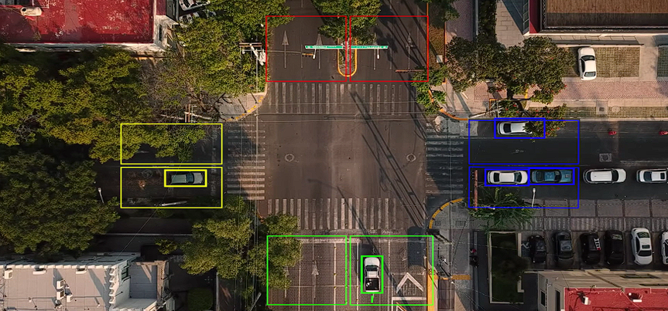
KIET Group of Institutions, Ghaziabad

Slide 10
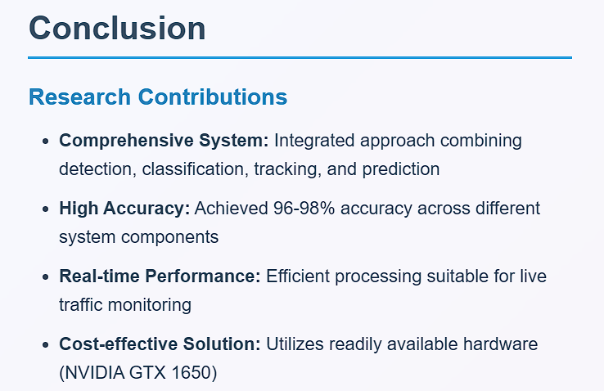
KIET Group of Institutions, Ghaziabad

Slide 11
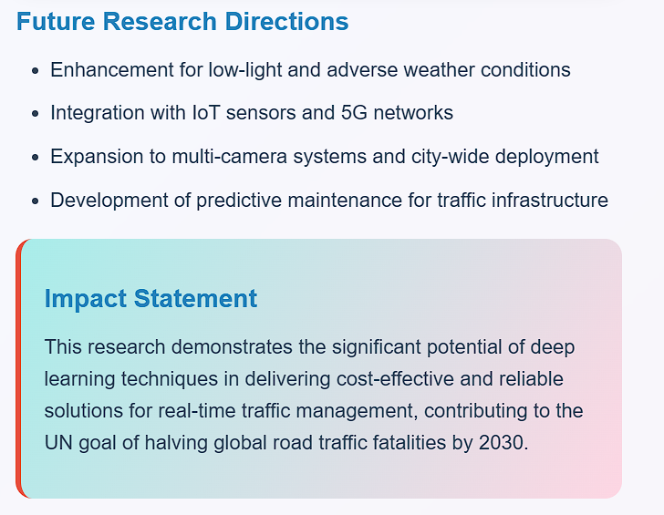
KIET Group of Institutions, Ghaziabad

Slide 12
KIET Group of Institutions, Ghaziabad
Thank You

